Slide 1
Introduction and Highlights of SeqAn and the BioStore Project
SeqAn Conference 2014

Slide 2
Seqan usability research & improvements

Slide 3
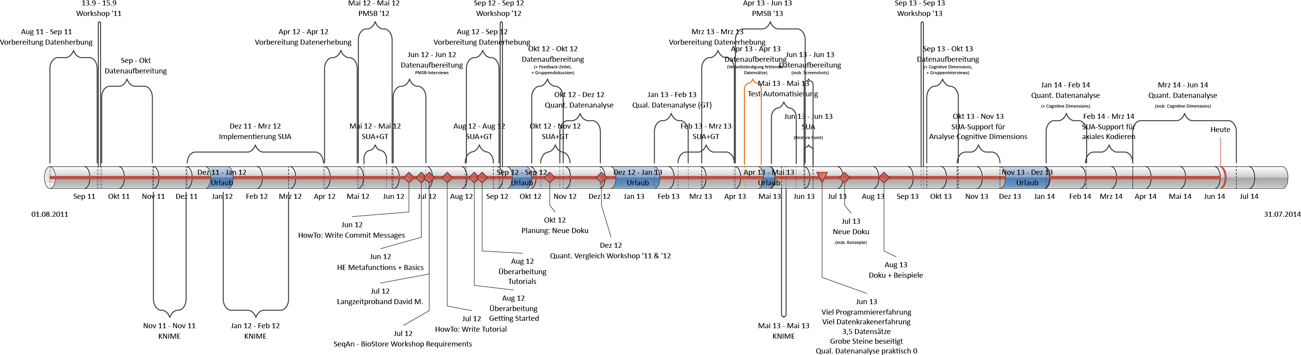
Usability Improvement Timeline

Slide 4
Research Approach
Core Research Method: Grounded Theory
Collected Data
coding and documentation usage of all workshop participants
(Group) Interviews
Questionnaires
Feedback
Cognitive Dimensions
Data Collection
Data Preparation
Open Coding
Axial Coding
Selective Coding
Sampling
Notes:
addOption(ArgumentParser, ArgParseOption)
ArgParseOption(short name, long name, description, datatype, label)
SYNOPSIS
Version
Last update missing

Slide 5
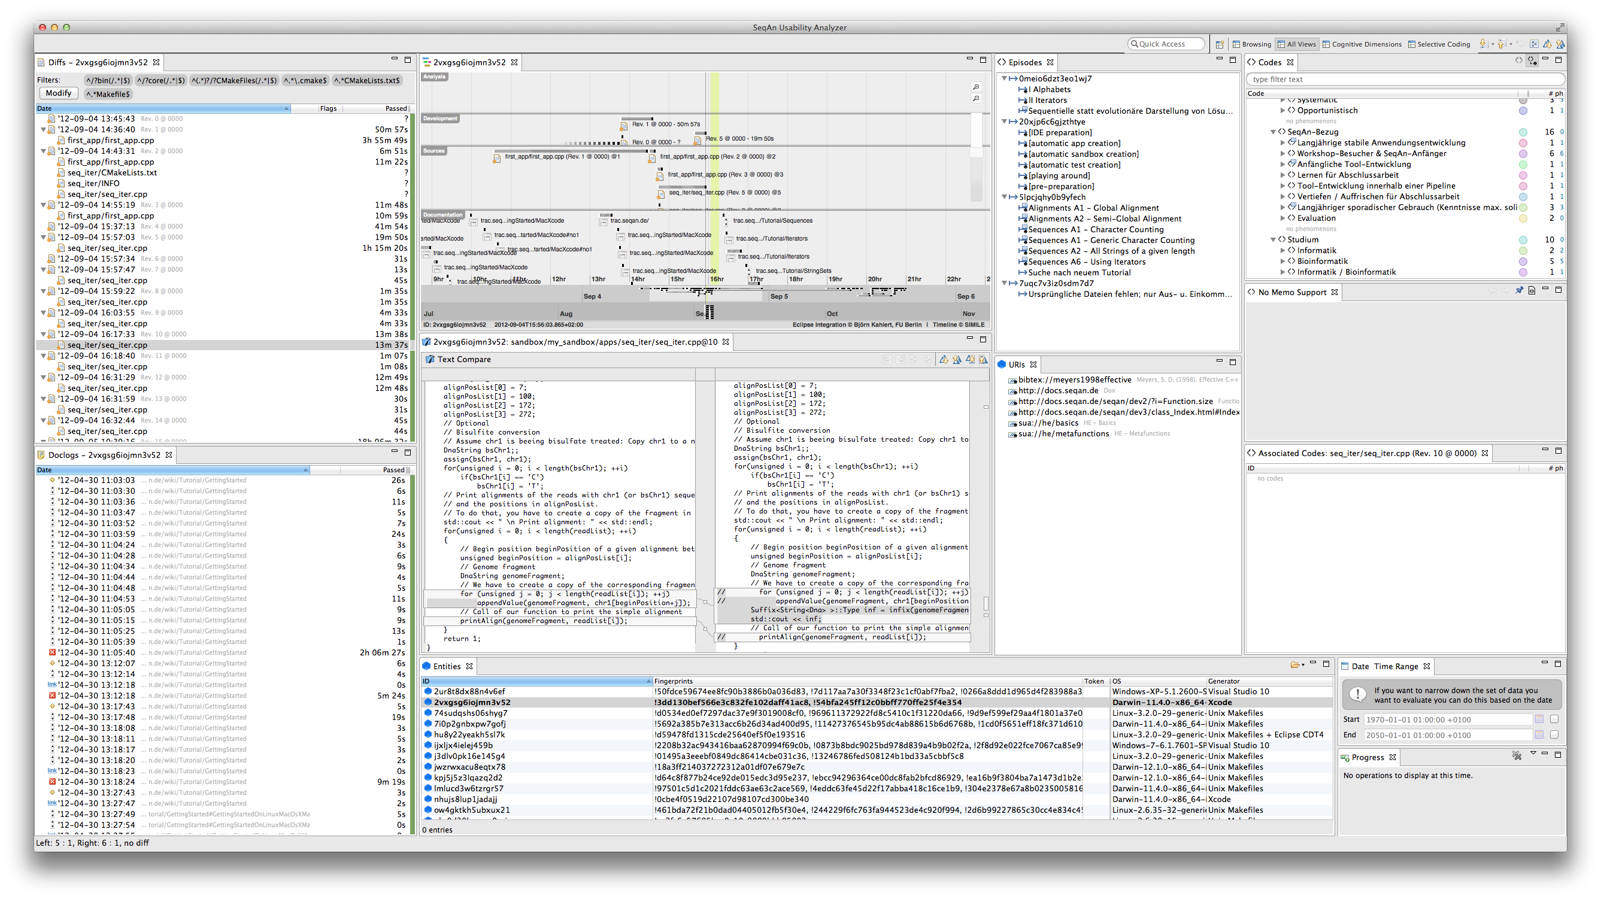
Usability Analysis Tool: SeqAn Usability Analyzer
TIMELINE
C files
Made changes
Pseudonymized participants

Slide 6
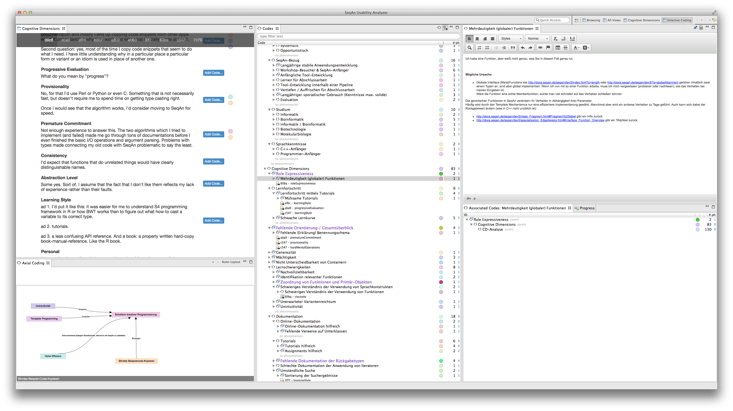
Usability Analysis Tool: SeqAn Usability Analyzer
Conceptualized Phenomenons
Memos
Annotated Questionnaire
Selective coding support

Slide 7
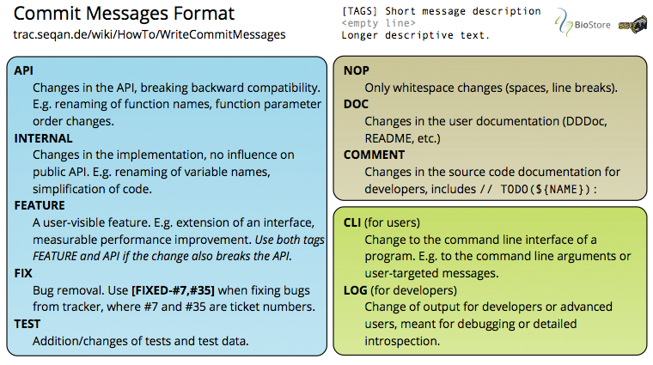
Improvements so far
Easier tracking of changes thanks to unified commit messages

Slide 8
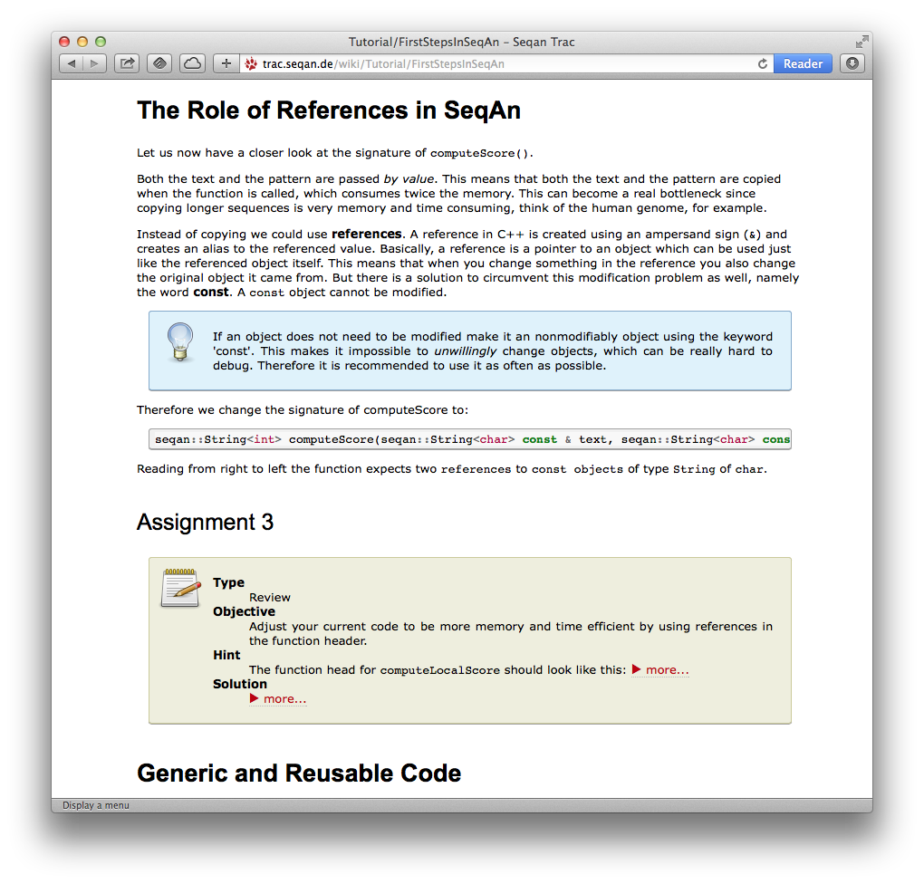
Improvements so far
Improved tutorials
Unified
Empasis on didactics

Slide 9
Improvements so far
New Documentation

Slide 10
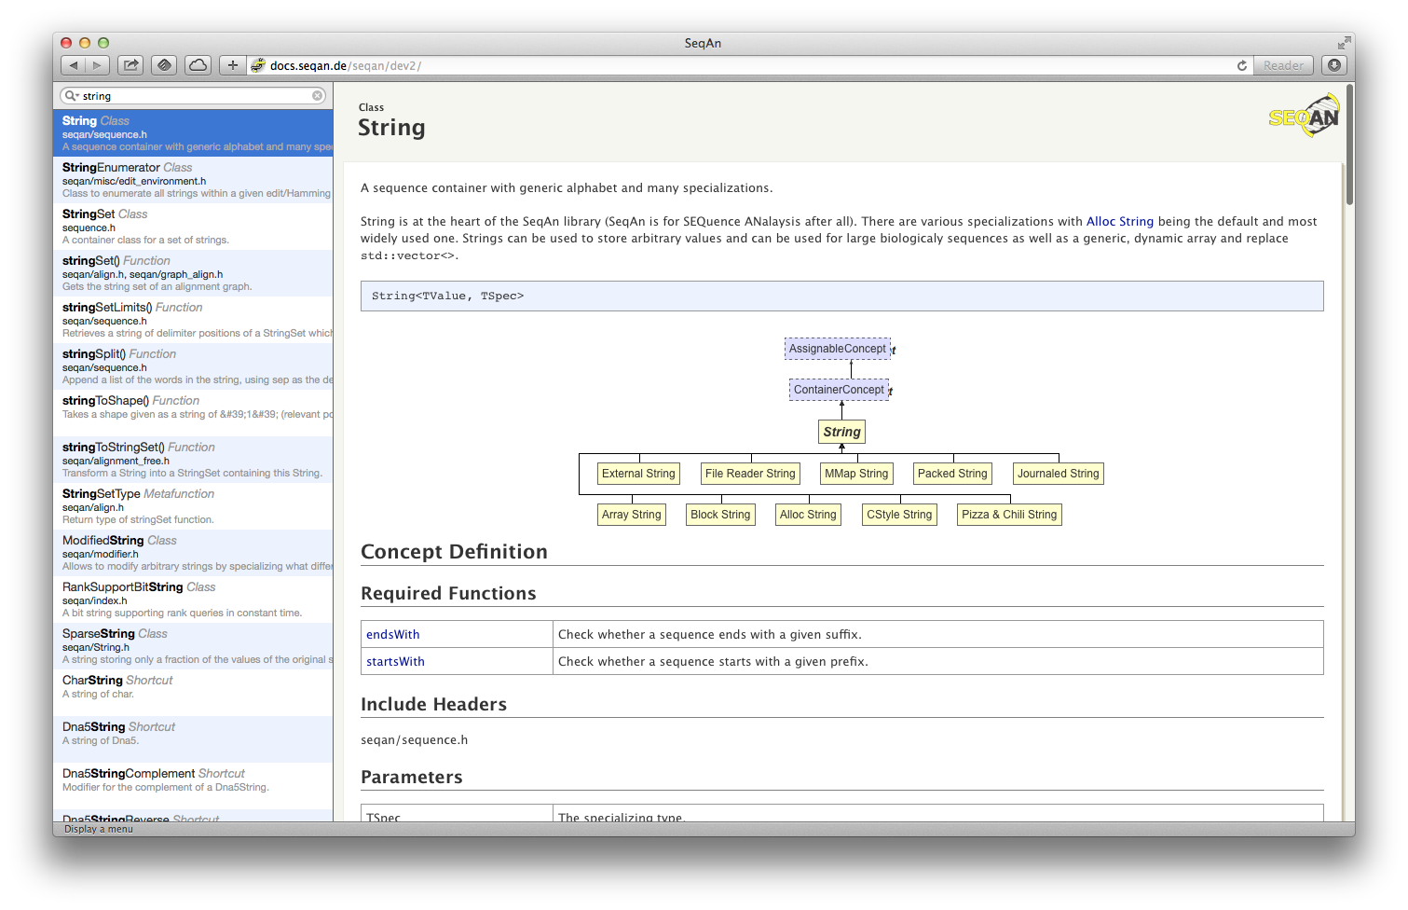

Slide 11
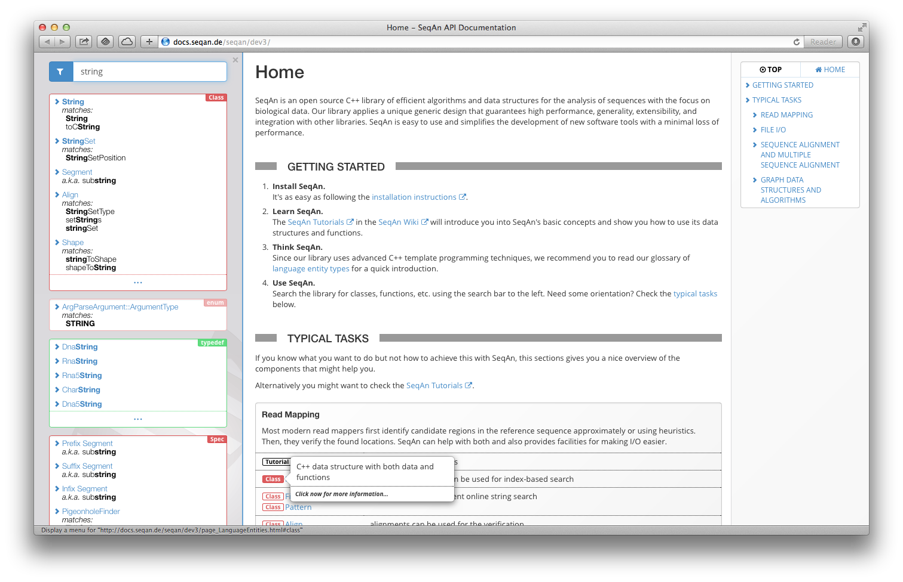
Filters
Navigation
GROUPING
REDUCTION
SYNONYMS
Type Annotations

Slide 12
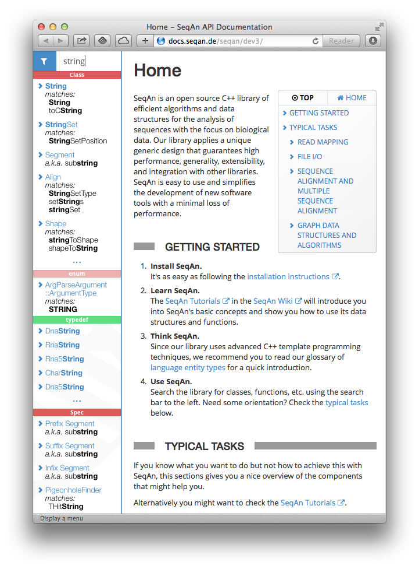
Space-saving

Slide 13
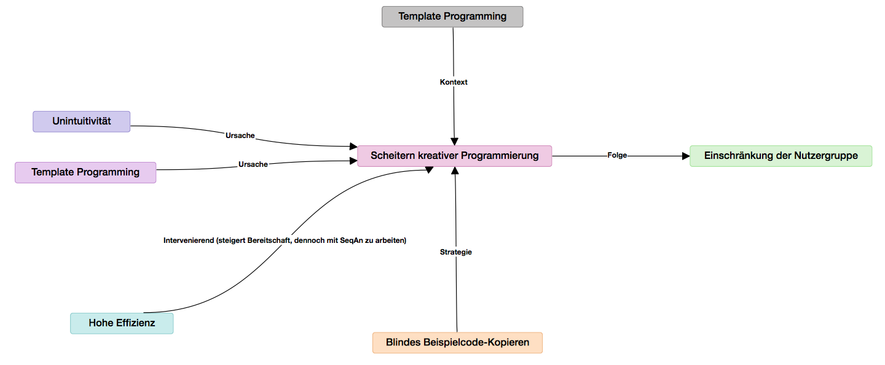
Improvements
Research not completed, yet
Deep insights expected

